Slide 1
Mutualism
Today’s Agenda:
Quiz
Preparing for the midterm
Network assignment
Mutualism

Slide 2
Preparing for the midterm
Next time is the midterm
Most of the questions will be recycled from the quizzes
May be modified (e.g., changed to multiple choice, reworded, etc)
So look over quizzes, particularly missed questions!
May be a few new things pulled from lectures or the book

Slide 3
Network Assignment
Consists of 3 parts:

Slide 4
Network Assignment
Consists of 3 parts:
Read papers before class on March 3!
16 options given (see the assignment details on Canvas for the list)
Don’t have to read all, but should read a subset of them
In-class discussion will be part of your grade!

Slide 5
Network Assignment
Consists of 3 parts:
Read papers before class on March 3!
Write about network(s) that might be useful for your question/system
Explain which network type(s) or representation(s) seem best suited to your system/question
Explain why these types/representations are well suited
Explain why other types/representations may not be a good fit.
Support your arguments with ideas from class, your readings, or your own reasoning, but remember to cite anything that comes from a published article.
One to two pages, double spaced (citations don’t count against the word limit)

Slide 6
Network Assignment
Consists of 3 parts:
Read papers before class on March 3!
Write about network(s) that might be useful for your question/system
How might network ecology help us to address big questions in ecology?
E.g., networks are integrated into species distribution modelling via joint SDMs, allowing prey distributions to inform predator distributions.
Write a short explanation (a page or so, double spaced) about how a major topic in ecology might benefit from integrating ecological networks.
For potential ideas of “major topics” you can look to your syllabus (competition, coexistence, biodiversity-ecosystem functioning, etc.), but aren’t limited to what is mentioned there.

Slide 7
Network Assignment
Grade Breakdown:
In-class participation and discussion 30%
Written portion 1 50%
Written portion 2 20%

Slide 8
Network Assignment
Questions?

Slide 9
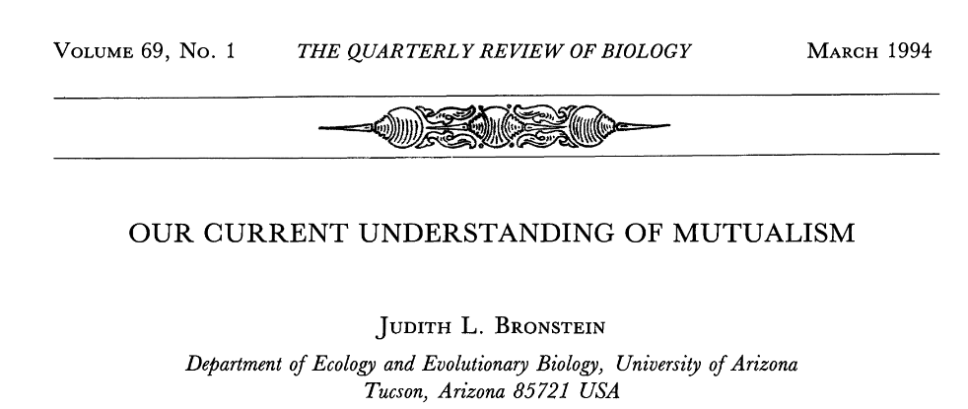
Definitions
 | Species A
Species B |  | + | 0 | -
 | + | ? | ? | ?
 | 0 | ? | ? | ?
 | - | ? | ? | ?

Slide 10
Definitions
 | Species A
Species B |  | + | 0 | -
 | + | Mutualism | Commensalism | Predation Parasitism
 | 0 | Commensalism | Neutralism | Amensalism
 | - | Predation Parasitism | Amensalism | Competition

Slide 11
Definitions
Facilitation: one species alters the environment in such a way that it benefits another species

Slide 12
Definitions
Obligate vs facultative mutualisms
Obligate: need a specific partner to live/reproduce/etc.
Facultative: don’t require a specific partner

Slide 13
Definitions
Obligate vs facultative mutualisms
Obligate: need a specific partner to live/reproduce/etc.
Facultative: don’t require a specific partner
Just because one partner is an obligate doesn’t mean the other is
A lot of (most?) interactions are asymmetrical

Slide 14
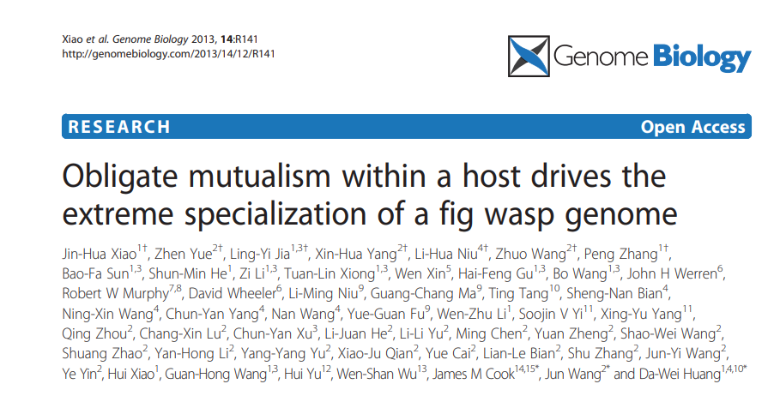
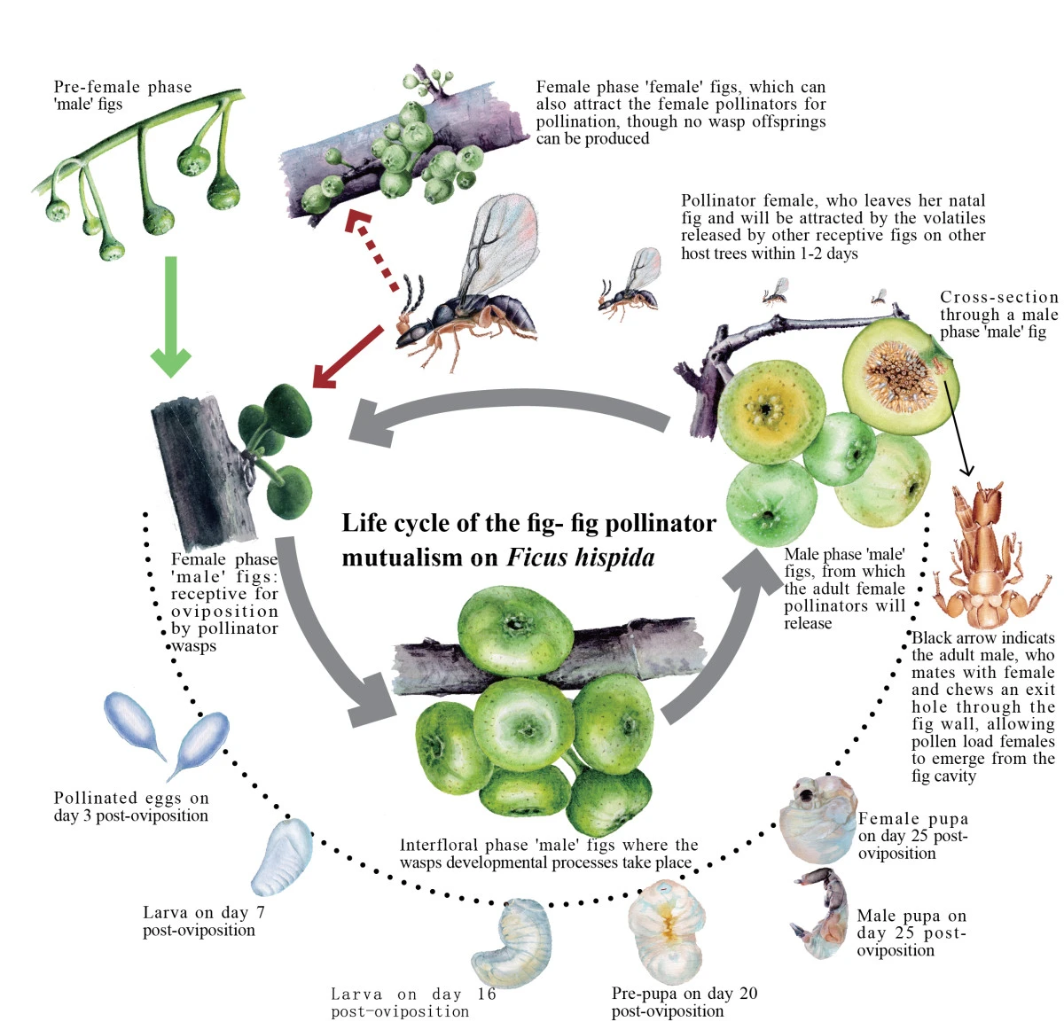
Obligate Mutualism Example

Slide 15
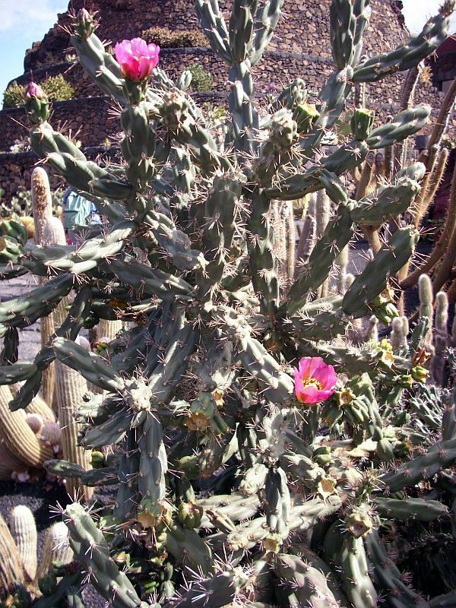
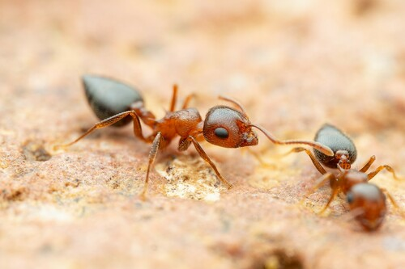
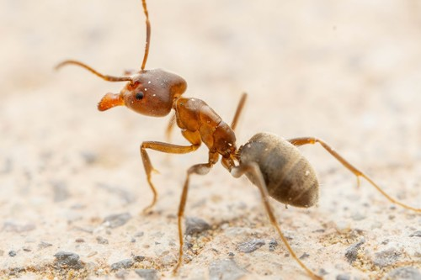
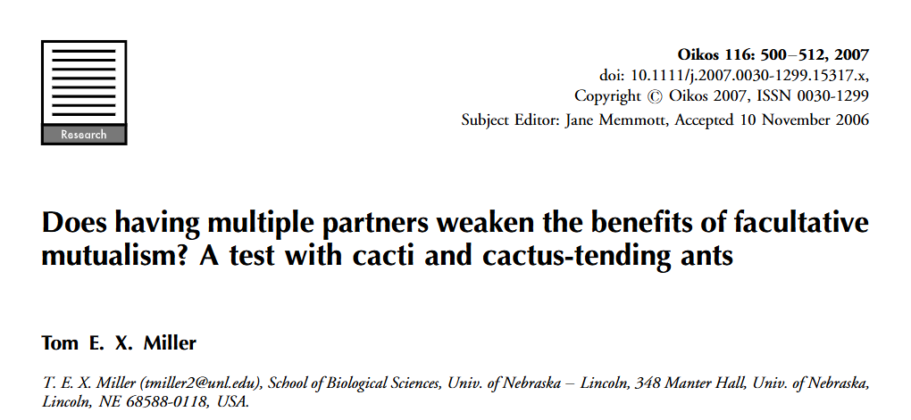
Facultative Mutualism Example
Crematogaster opuntiae
Liometopum apiculatum
Cylindropuntia imbricata
Photos: Peter A. Mansfeld CC-BY; Jake Nitta CC-BY;

Slide 16
Facultative Mutualism Example
Crematogaster opuntiae
Liometopum apiculatum
Bad defense
Good Defense
Cylindropuntia imbricata
Extrafloral nectaries
Photos: Peter A. Mansfeld CC-BY; Jake Nitta CC-BY;

Slide 17
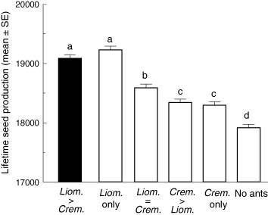
Facultative Mutualism Example
Crematogaster opuntiae
Bad defense
Cylindropuntia imbricata
Photos: Peter A. Mansfeld CC-BY; Jake Nitta CC-BY;

Slide 18
Facultative Mutualism Example
 | Species A
Species B |  | + | 0 | -
 | + | Mutualism | Commensalism | Predation Parasitism
 | 0 | Commensalism | Neutralism | Amensalism
 | - | Predation Parasitism | Amensalism | Competition
Photos: Peter A. Mansfeld CC-BY; Jake Nitta CC-BY;

Slide 19
Evolution of Mutualism
Costs vs benefits
Evolution only ‘cares’ about net benefits to a species
Want to minimize costs
Selection pushes towards parasitism
 | Species A
Species B |  | + | 0 | -
 | + | Mutualism | Commensalism | Predation Parasitism
 | 0 | Commensalism | Neutralism | Amensalism
 | - | Predation Parasitism | Amensalism | Competition
Notes:
Mutualism = mutual exploitation

Slide 20
Evolution of Mutualism
How are mutualisms maintained?
Partner fidelity (e.g., lichen, chloroplasts)
Partner choice (only choose reliable partners)

Slide 21
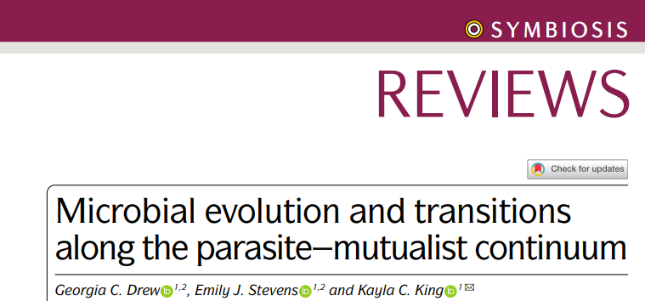
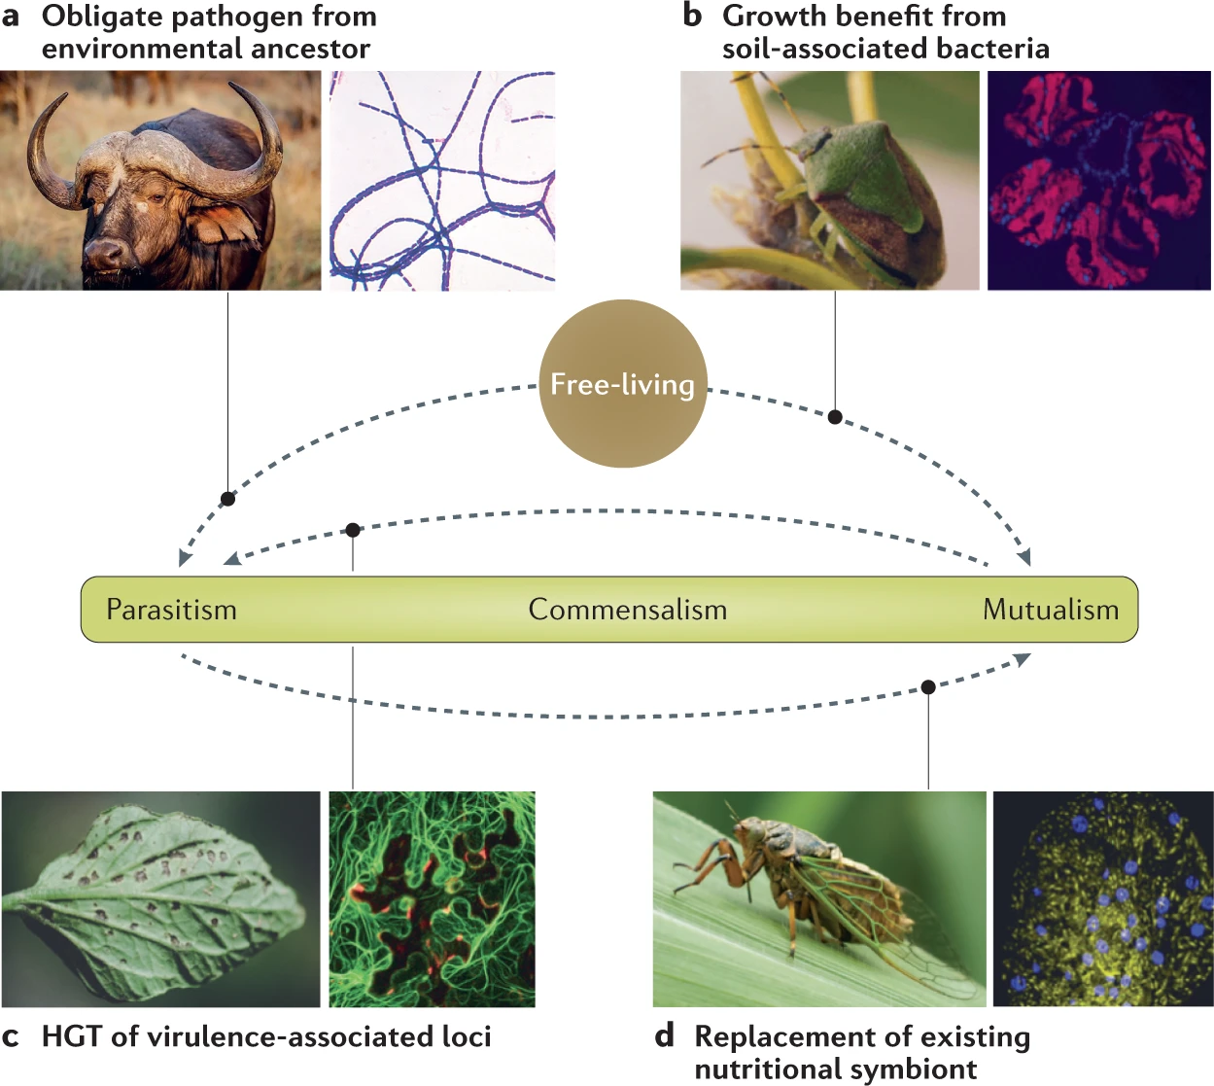
Changes in Evolutionary Time

Slide 22
Early issues with integrating mutualism into theory
Why does mutualism lag behind competition and predation?

Slide 23
Early issues with integrating mutualism into theory
Remember these competition models?
dN₁
k₁ - N₁ - α₁₂N₂
dN₂
k₂ - N₂ - α₂₁N₁
=
r₁N₁
=
r₂N₂
dt
k₁
dt
k₂
dN₁/dT = rate of change in N₁
k₁ = carrying capacity of species 1
N₁ = # species 1
N₂ = # species 2
α₁₂ = relative impact of sp. 2 on sp. 1
dN₂/dT = rate of change in N₂
k₂ = carrying capacity of species 2
α₂₁ = relative impact of sp. 1 on sp. 2

Slide 24
Early issues with integrating mutualism into theory
Remember these competition models? - Now they’re mutualism models
dN₁
k₁ - N₁ + α₁₂N₂
dN₂
k₂ - N₂ + α₂₁N₁
=
r₁N₁
=
r₂N₂
dt
k₁
dt
k₂
dN₁/dT = rate of change in N₁
k₁ = carrying capacity of species 1
N₁ = # species 1
N₂ = # species 2
α₁₂ = relative impact of sp. 2 on sp. 1
dN₂/dT = rate of change in N₂
k₂ = carrying capacity of species 2
α₂₁ = relative impact of sp. 1 on sp. 2

Slide 25
Early issues with integrating mutualism into theory
Where can species 1 invade?
dN₁
k₁ - N₁ + α₁₂N₂
dN₂
k₂ - N₂ + α₂₁N₁
=
r₁N₁
=
r₂N₂
dt
k₁
dt
k₂
dN₁/dT = rate of change in N₁
k₁ = carrying capacity of species 1
N₁ = # species 1
N₂ = # species 2
α₁₂ = relative impact of sp. 2 on sp. 1
dN₂/dT = rate of change in N₂
k₂ = carrying capacity of species 2
α₂₁ = relative impact of sp. 1 on sp. 2

Slide 26
Zero Net Growth Isoclines (ZNGIs)
dN₁
k₁ - N₁ + α₁₂N₂
dN₂
k₂ - N₂ + α₂₁N₁
=
r₁N₁
=
r₂N₂
dt
k₁
dt
k₂

Slide 27
Zero Net Growth Isoclines (ZNGIs)
k₁ - N₁ + α₁₂N₂
k₂ - N₂ + α₂₁N₁
0
=
r₁N₁
0
=
r₂N₂
k₁
k₂

Slide 28
Zero Net Growth Isoclines (ZNGIs)
k₁ - N₁ + α₁₂N₂
k₂ - N₂ + α₂₁N₁
0
=
0
=
k₁
k₂

Slide 29
Zero Net Growth Isoclines (ZNGIs)
k₁ - N₁ + α₁₂N₂
k₂ - N₂ + α₂₁N₁
0
=
0
=

Slide 30
Zero Net Growth Isoclines (ZNGIs)
N₁
=
k₁ + α₁₂N₂
α₂₁N₁
=
N₂ - k₂

Slide 31
Zero Net Growth Isoclines (ZNGIs)
N₂ - k₂
N₁
=
k₁ + α₁₂N₂
N₁
=
α₂₁
Notes:
Define where species grow/shrink

Slide 32
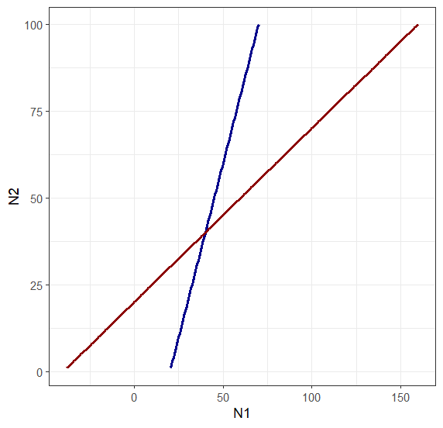
Zero Net Growth Isoclines (ZNGIs)
Species 1
Species 2
Notes:
Define where species grow/shrink

Slide 33
Zero Net Growth Isoclines (ZNGIs)
Species 1
Species 2
Can lead to coexistence
Notes:
Define where species grow/shrink

Slide 34
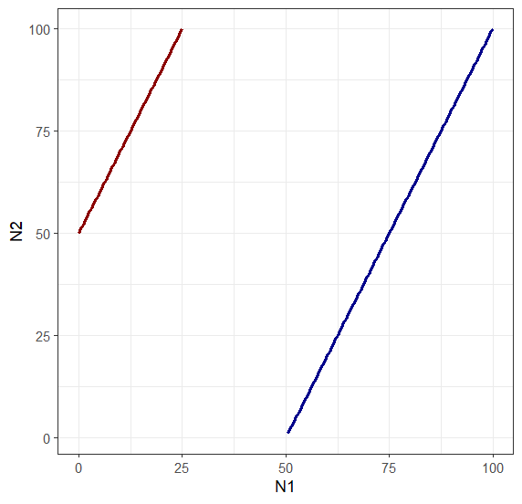
Zero Net Growth Isoclines (ZNGIs)
Species 1
Species 2
Can also lead to unlimited growth!
Notes:
Define where species grow/shrink

Slide 35
Early issues with integrating mutualism into theory
Why don’t we see this unlimited growth among mutualistic partners in nature?

Slide 36
Early issues with integrating mutualism into theory
Why don’t we see this unlimited growth among mutualistic partners in nature?
Mutualisms have costs!
This is also why they evolution and context can alter them!

Slide 37
Context dependency
Changing conditions may lead to changes in interaction types
 | Species A
Species B |  | + | 0 | -
 | + | Mutualism | Commensalism | Predation Parasitism
 | 0 | Commensalism | Neutralism | Amensalism
 | - | Predation Parasitism | Amensalism | Competition

Slide 38
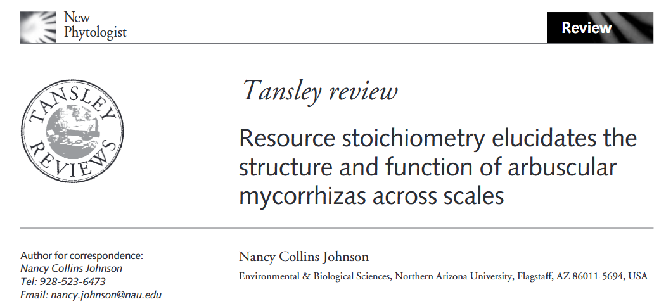
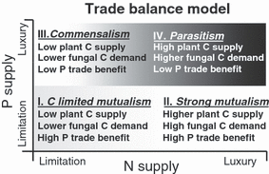
Context dependency: AMF+Plants

Slide 39
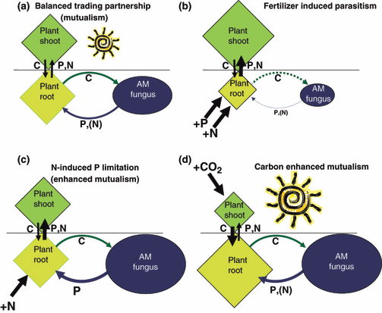
Context dependency: AMF+Plants

Slide 40
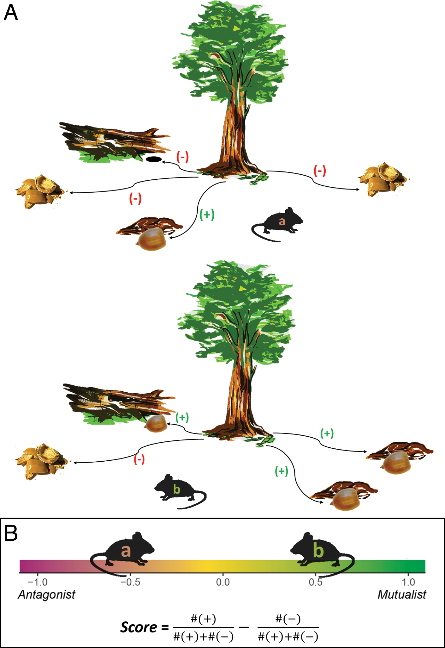
Context dependency: Seeds and Mice

Slide 41
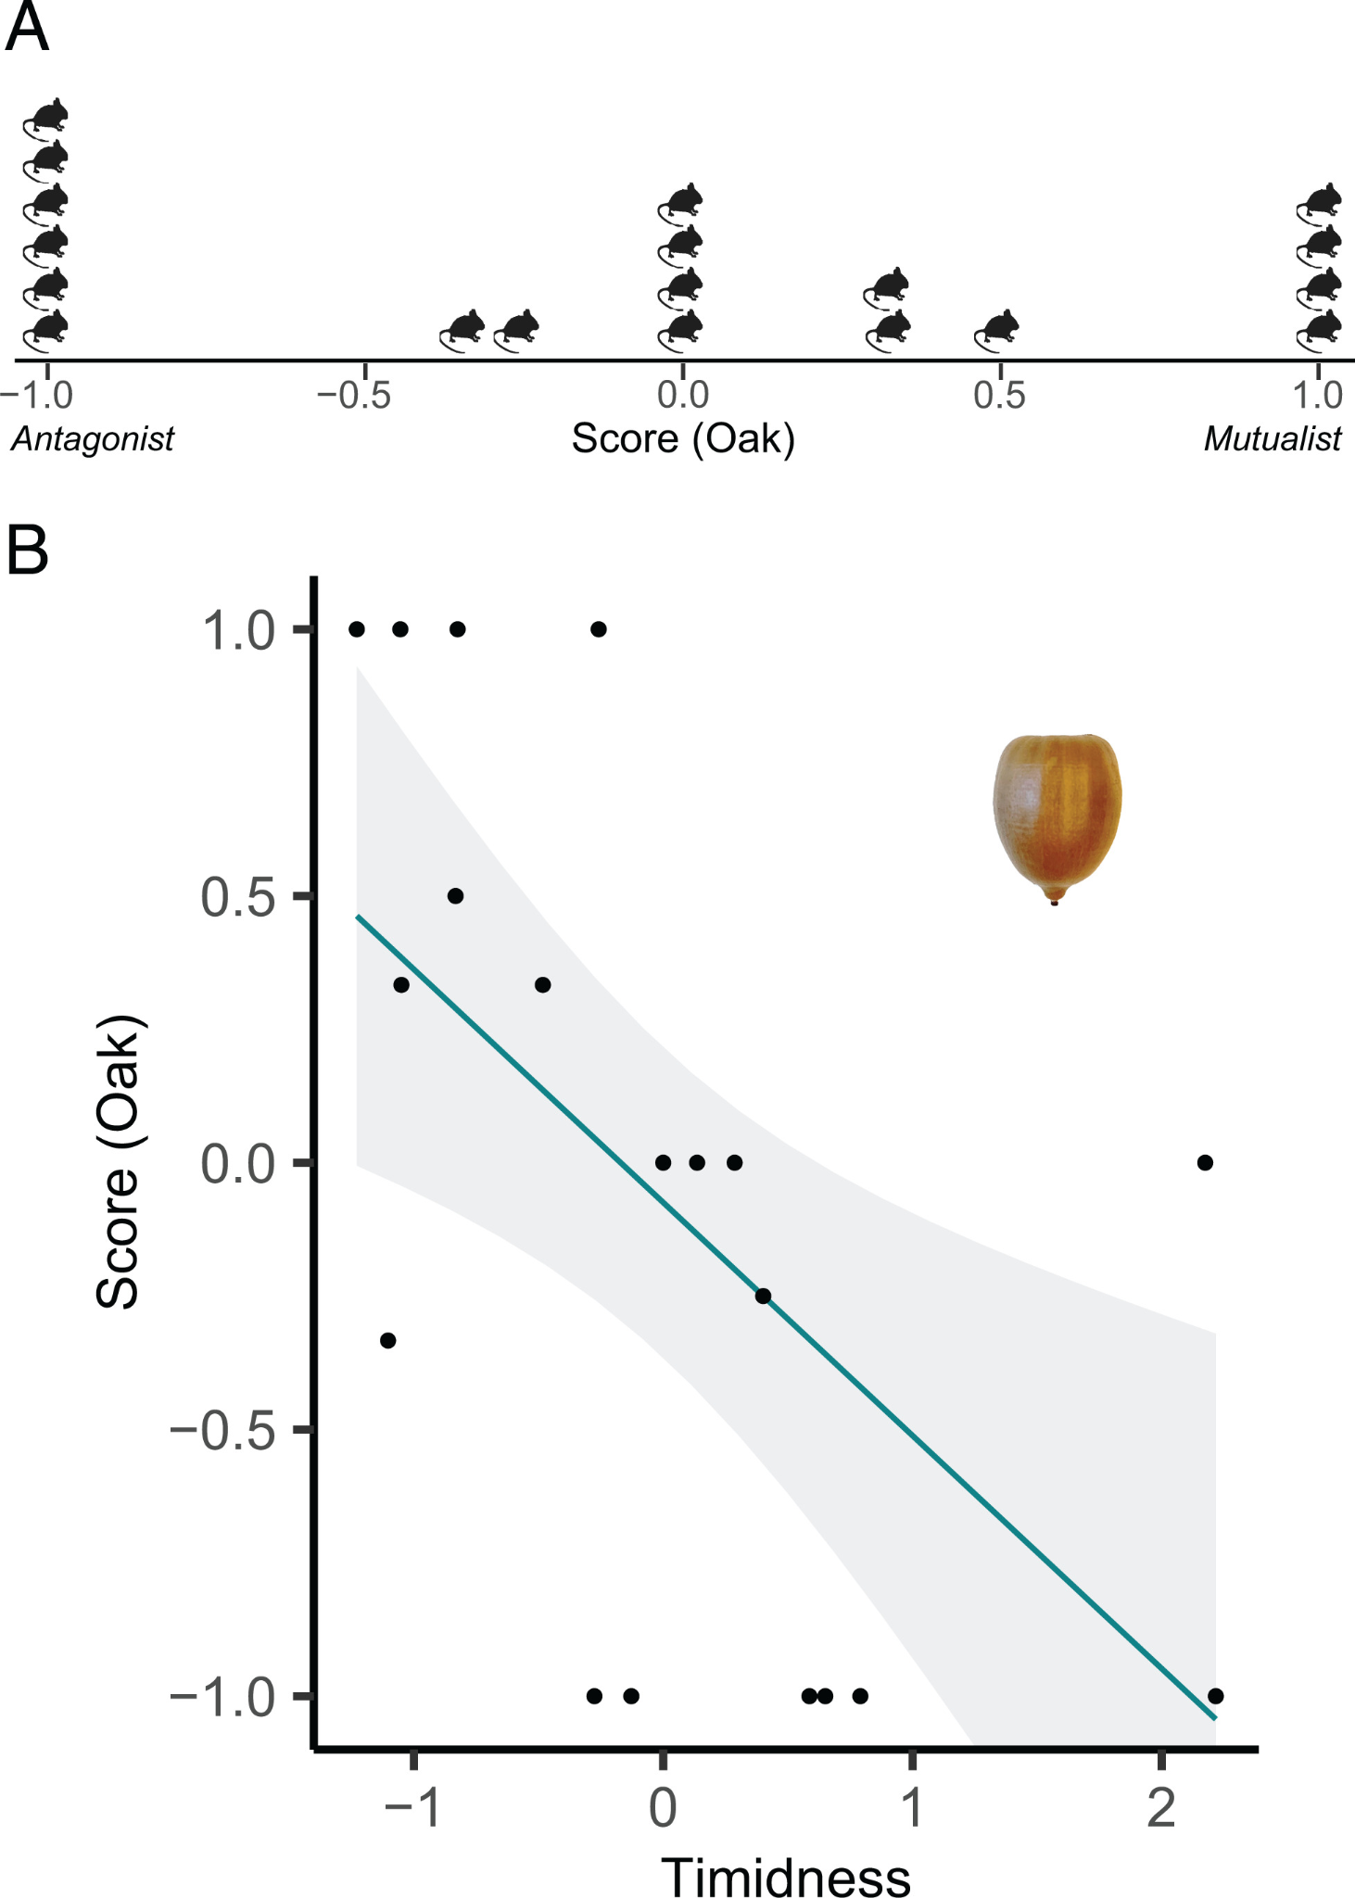
Context dependency: Seeds and Mice

Slide 42
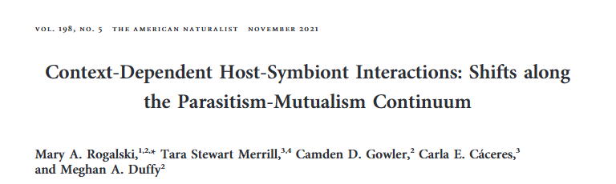
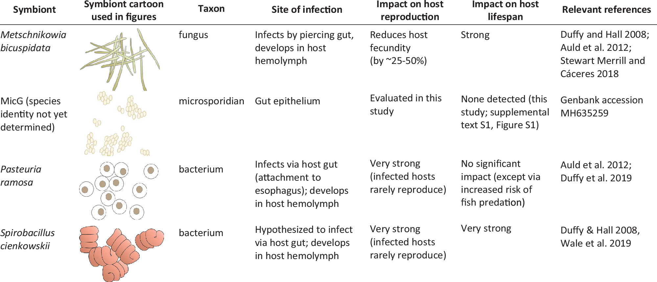
Context dependency: Daphnia parasites

Slide 43
Context dependency: Daphnia parasites

Slide 44
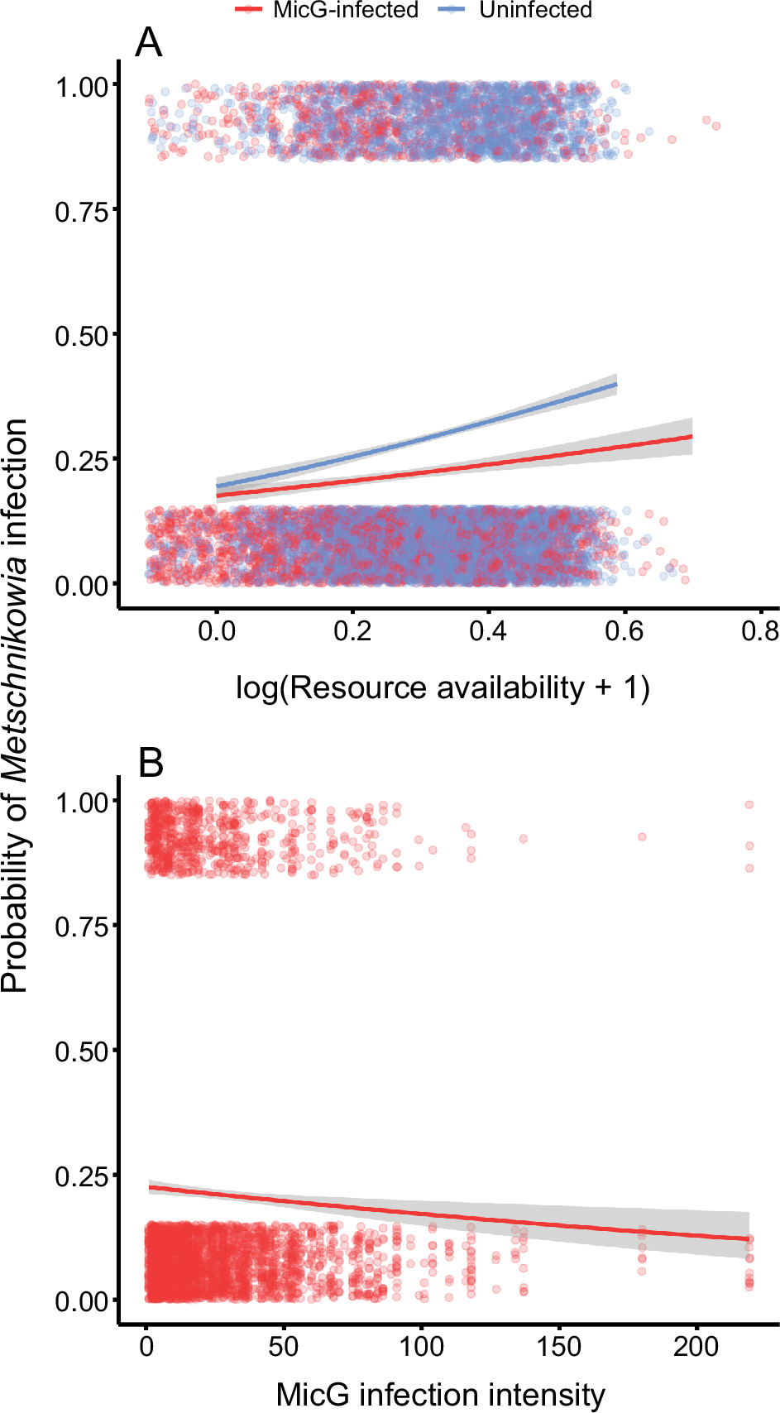
Context dependency: Daphnia parasites

Slide 45
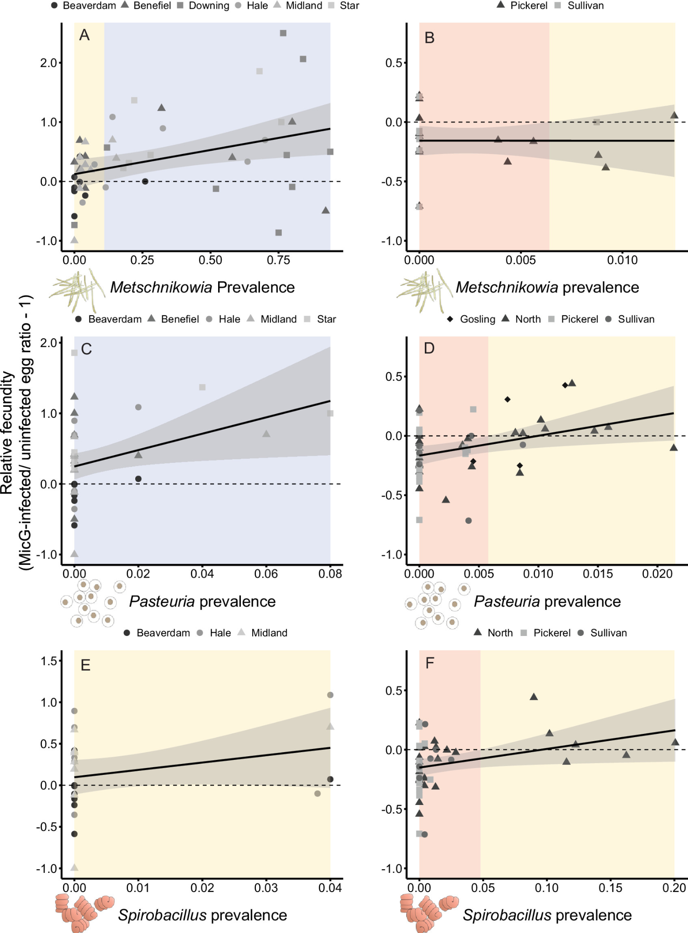
Context dependency: Daphnia parasites
Red = Parasitism
Yellow = Commensalism
= Mutualism

Slide 46
Context dependency
 | Species A
Species B |  | + | 0 | -
 | + | Mutualism | Commensalism | Predation Parasitism
 | 0 | Commensalism | Neutralism | Amensalism
 | - | Predation Parasitism | Amensalism | Competition

Slide 47
Context dependency
 | Species A
Species B |  | + | 0 | -
 | + | Mutualism | Commensalism | Predation Parasitism
 | 0 | Commensalism | Neutralism | Amensalism
 | - | Predation Parasitism | Amensalism | Competition
Notes:
Why don’t we see some of these other transitions?

Slide 48
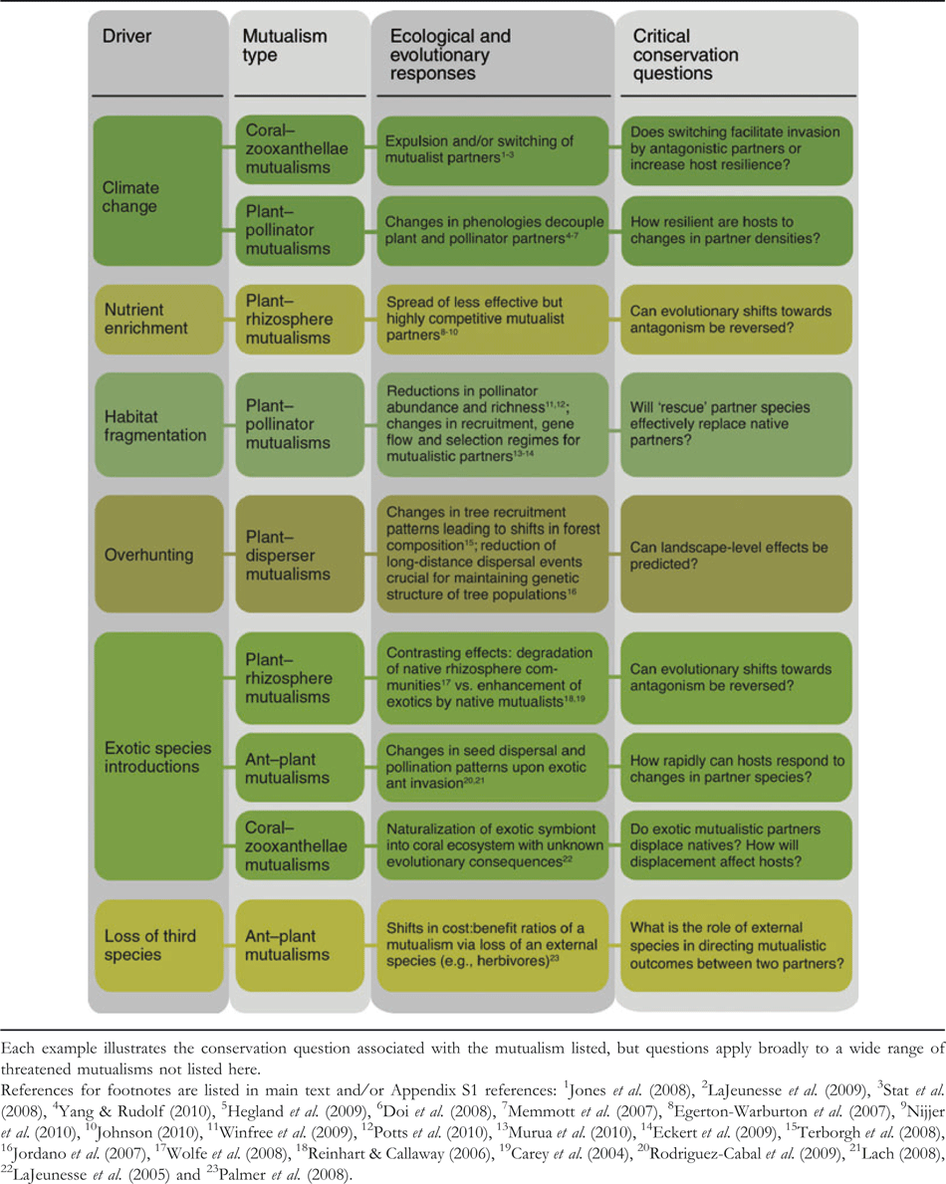
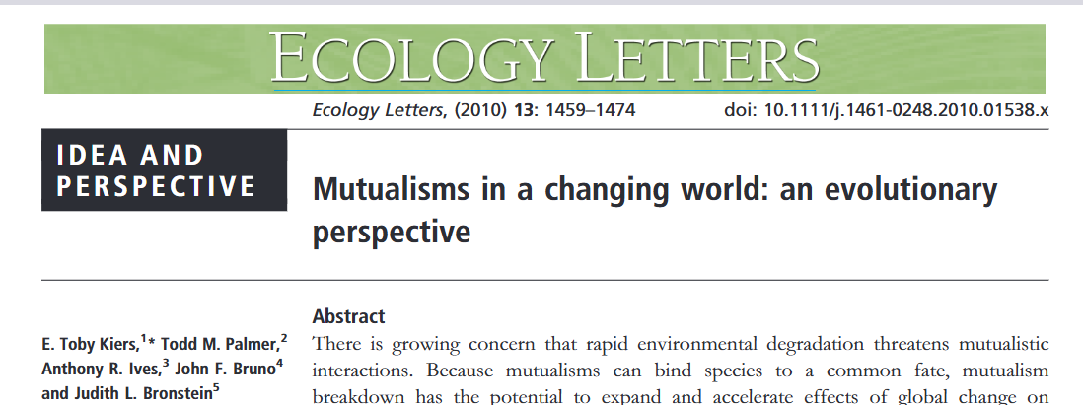
Mutualism and conservation

Slide 49
Next class: Midterm

